Slide 1
Azure Security Fundamentals
Trainer Name – Trainer Title
Notes:
Version 0.5

Slide 2
Agenda
Azure Security Overview
Identity
Subscription Management
Azure Blueprints
Azure Security Center
Azure Monitor

Slide 3
Agenda
Time Permitting
Azure Key Vault
Azure Network Security
Azure Storage Security
Azure SQL Security

Slide 4
Introduction and Logistics
Your trainer
You
Your role
Your company
Your experience in this technology area
Your goals for this workshop
Start and end times
Facilities (bathrooms, smoking)
Meals
Computers, phones, tablets, etc.
Please set to vibrate
What’s on your desk?

Slide 5
Microsoft Trusted Cloud Principles

Slide 6
Microsoft Trusted Cloud Principles - Security
Security Development Lifecycle
Cyber Defense Operations Center
Built-in product security
Data privacy
Azure Active Directory
Data encryption
Notes:
Security
Help keep your data secure
Security Development Lifecycle, a mandatory development process that embeds security requirements into our software.
Cyber Defense Operations Center that protects Microsoft’s cloud infrastructure, services, products, devices, and our own corporate resources from evolving threats.
Built-in product security designed to help meet your organization’s needs for robust security, reliability, and user productivity, with reduced time and costs.
Data privacy controls and visibility into where your data resides and who has access to it.
Azure Active Directory (Azure AD) for secure identity in managing users, providing authentication, including Multi-Factor Authentication (MFA), and access control.
Data encryption methods that stay a step ahead of cybercriminals, providing you additional security for data at rest, on the wire, or within applications.
Privacy
Protect your right to control and make decisions about your data.
Control—We will put you in control of your privacy with easy-to-use tools and clear choices.
Transparency—We will be transparent about data collection and use so you can make informed decisions.
Security—We will protect the data you entrust to us through strong security and encryption.
Strong legal protections—We will respect your local privacy laws and fight for legal protection of your privacy as a fundamental human right.
No content-based targeting—We will not use your email, chat, files, or other personal content to target ads to you.
Benefits to you—When you opt-in and we collect your data, we will use it to benefit you and to make your experiences better when using Microsoft products.
Compliance
Manage your data in compliance with law.
https://www.microsoft.com/en-us/trustcenter/compliance/complianceofferings
Microsoft Compliance Manager,
Discover—Identify what personal data you have and where it resides.
Manage—Govern how personal data is used and accessed.
Protect—Establish security controls to prevent, detect, and respond to vulnerabilities and data breaches.
Report—Keep required documentation and manage data requests and breach notifications.
Transparency
Be transparent about our enterprise cloud services.
Microsoft believes that people and organizations have a right to as much information as possible about how we handle their data in the cloud. We make our policies and practices clear and accessible to everyone on our Corporate and Social Responsibility Reports Hub. We also provide clear explanations about where the data is stored, how we help secure it, who can access it, and under what circumstances. This is how we demonstrate our principle of transparency.
https://www.microsoft.com/corporate-responsibility/reports-hub
[EDITOR] TWB_Trevor:
09 October 2013 It seems odd to use “finally” here, given that this is not a long process – or, at least, has not been described in great detail. Kindly consider removing it, or replacing it with something that clarifies context.

Slide 7
Microsoft Trusted Cloud Principles - Privacy
Protect
Control
Transparency
Security
Strong legal protections
No content-based targeting
Benefits to you
Notes:
Privacy
Protect your right to control and make decisions about your data.
Control—We will put you in control of your privacy with easy-to-use tools and clear choices.
Transparency—We will be transparent about data collection and use so you can make informed decisions.
Security—We will protect the data you entrust to us through strong security and encryption.
Strong legal protections—We will respect your local privacy laws and fight for legal protection of your privacy as a fundamental human right.
No content-based targeting—We will not use your email, chat, files, or other personal content to target ads to you.
Benefits to you—When you opt-in and we collect your data, we will use it to benefit you and to make your experiences better when using Microsoft products.
Compliance
Manage your data in compliance with law.
https://www.microsoft.com/en-us/trustcenter/compliance/complianceofferings
Microsoft Compliance Manager,
Discover—Identify what personal data you have and where it resides.
Manage—Govern how personal data is used and accessed.
Protect—Establish security controls to prevent, detect, and respond to vulnerabilities and data breaches.
Report—Keep required documentation and manage data requests and breach notifications.
Transparency
Be transparent about our enterprise cloud services.
Microsoft believes that people and organizations have a right to as much information as possible about how we handle their data in the cloud. We make our policies and practices clear and accessible to everyone on our Corporate and Social Responsibility Reports Hub. We also provide clear explanations about where the data is stored, how we help secure it, who can access it, and under what circumstances. This is how we demonstrate our principle of transparency.
https://www.microsoft.com/corporate-responsibility/reports-hub
[EDITOR] TWB_Trevor:
09 October 2013 It seems odd to use “finally” here, given that this is not a long process – or, at least, has not been described in great detail. Kindly consider removing it, or replacing it with something that clarifies context.

Slide 8
Microsoft Trusted Cloud Principles - Compliance
Compliance Offerings
Microsoft Compliance Manager
Notes:
Compliance
Manage your data in compliance with law.
https://www.microsoft.com/en-us/trustcenter/compliance/complianceofferings
Microsoft Compliance Manager,
Discover—Identify what personal data you have and where it resides.
Manage—Govern how personal data is used and accessed.
Protect—Establish security controls to prevent, detect, and respond to vulnerabilities and data breaches.
Report—Keep required documentation and manage data requests and breach notifications.
[EDITOR] TWB_Trevor:
09 October 2013 It seems odd to use “finally” here, given that this is not a long process – or, at least, has not been described in great detail. Kindly consider removing it, or replacing it with something that clarifies context.

Slide 9
Microsoft Trusted Cloud Principles - Transparency
Corporate and Social Responsibility Reports Hub
Notes:
Transparency
Be transparent about our enterprise cloud services.
Microsoft believes that people and organizations have a right to as much information as possible about how we handle their data in the cloud. We make our policies and practices clear and accessible to everyone on our Corporate and Social Responsibility Reports Hub. We also provide clear explanations about where the data is stored, how we help secure it, who can access it, and under what circumstances. This is how we demonstrate our principle of transparency.
https://www.microsoft.com/corporate-responsibility/reports-hub
[EDITOR] TWB_Trevor:
09 October 2013 It seems odd to use “finally” here, given that this is not a long process – or, at least, has not been described in great detail. Kindly consider removing it, or replacing it with something that clarifies context.

Slide 10
Azure
Notes:
Use this as a pointer to whiteboard an Azure overview if your audience has never touched Cloud before.

Slide 11
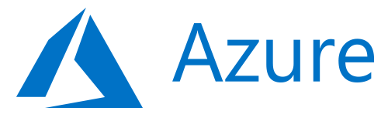
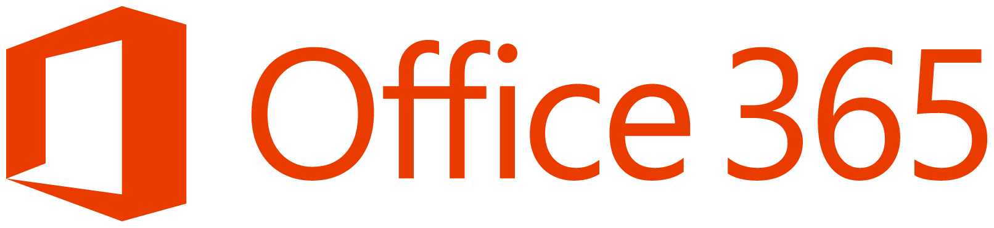
Cloud Computing Stack
Packaged Software
Infrastructure
(as a Service)
Platform
(as a Service)
Software
(as a Service)
You manage
Applications
Applications
Applications
Applications
Data
You manage
Data
Data
Data
Runtime
Runtime
Runtime
Runtime
Managed by vendor
You manage
Middleware
Middleware
Middleware
Managed by vendor
Middleware
O/S
O/S
O/S
O/S
Virtualization
Virtualization
Managed by vendor
Virtualization
Virtualization
Servers
Servers
Servers
Servers
Storage
Storage
Storage
Storage
Networking
Networking
Networking
Networking
Notes:
Discuss the stack, starting at the bottom.
Click
Discuss that in IaaS the vendor manages everything except the guest operating system.
Click
Discuss that in PaaS the vendor manages the underlying operating System.
You manage the Applications, and the Data
You pick the runtime, e.g. .NET or PHP
You pick the platform, e.g. SQL or NoSQL
Click
Discuss that in SaaS the vendor manages everything
The client consumes the service
E.g. Mailbox or SharePoint Site
There is no patching or operating systems
You don’t need to know what version of software the platform runs on
The difference? You build upon Infrastructure and Platform, where as you consume Software.
EG – IIS or VM on their own don’t do much. However an exchange mailbox on it’s own is something you can use.

Slide 12

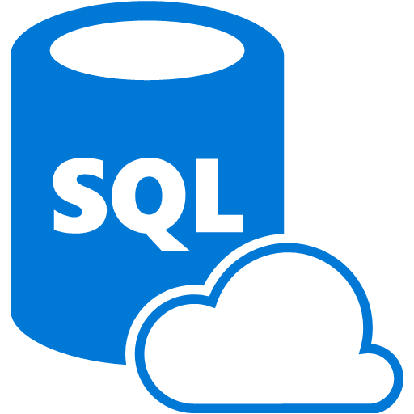







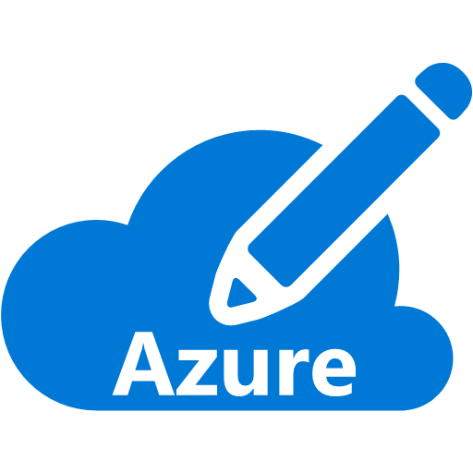



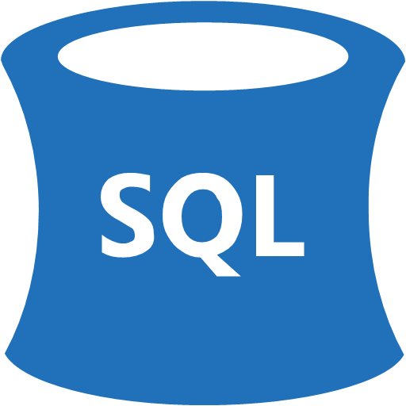


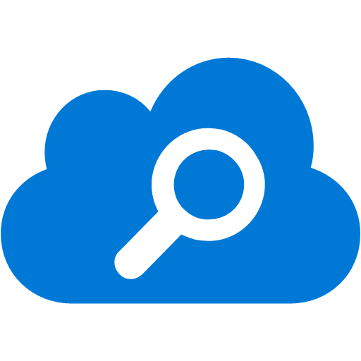





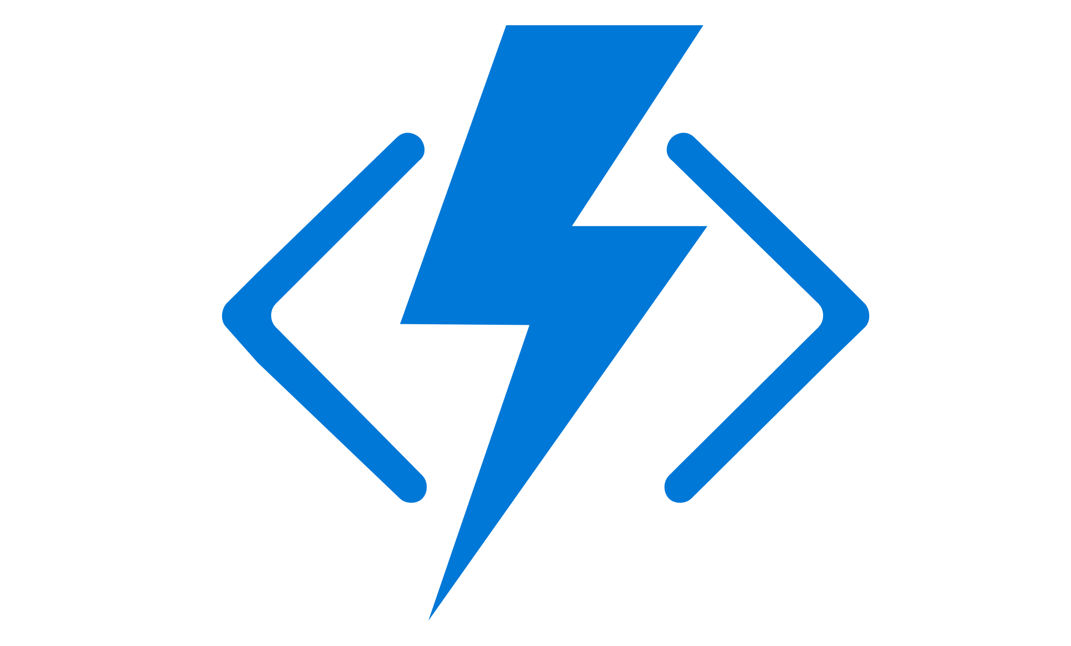


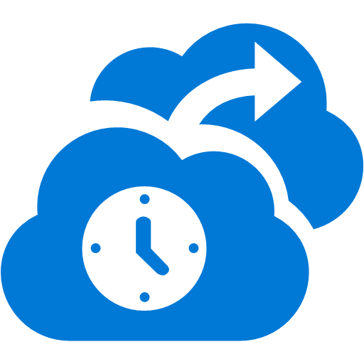








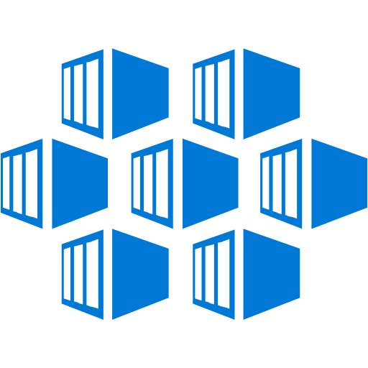
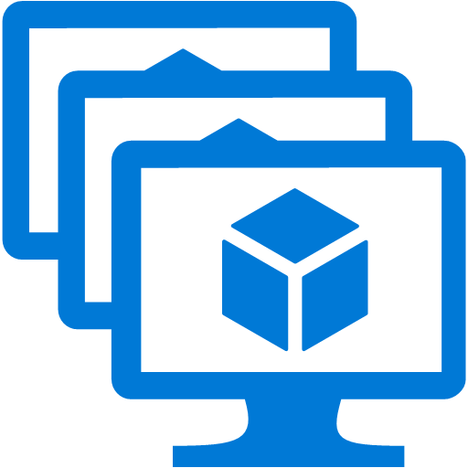
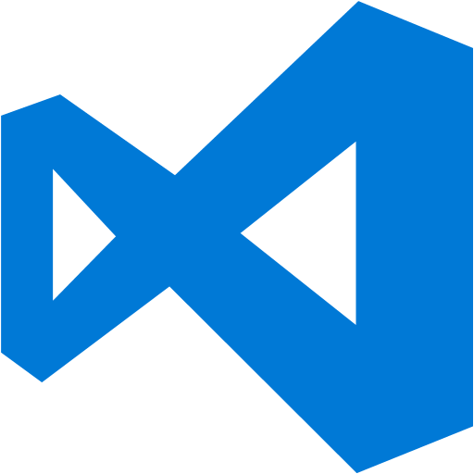

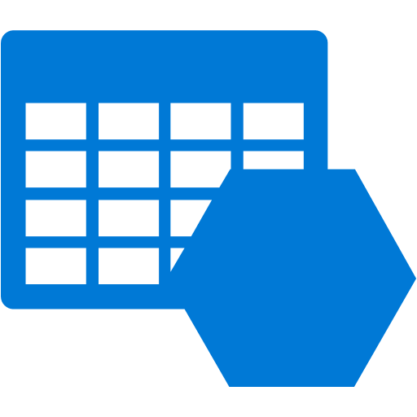

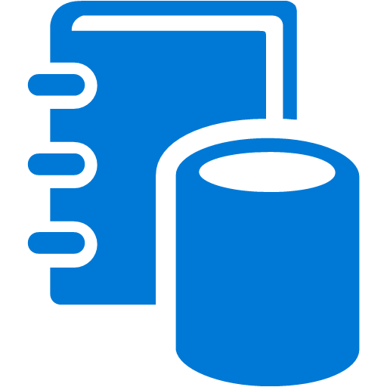

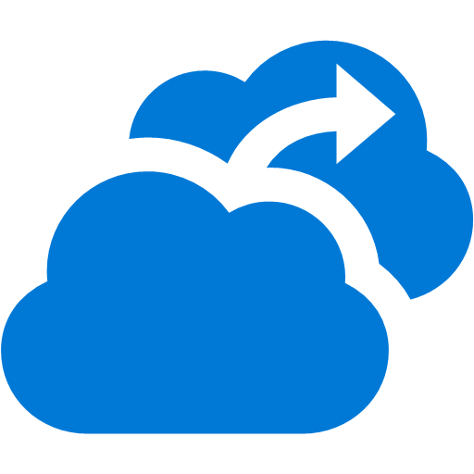

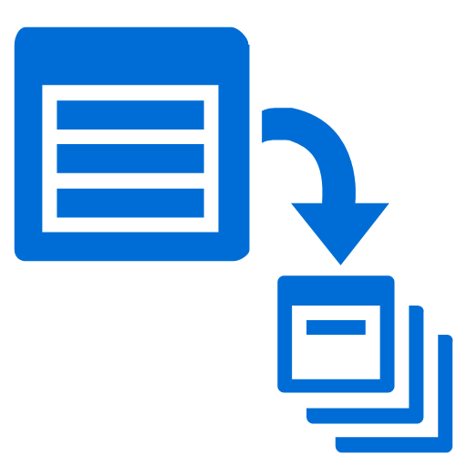










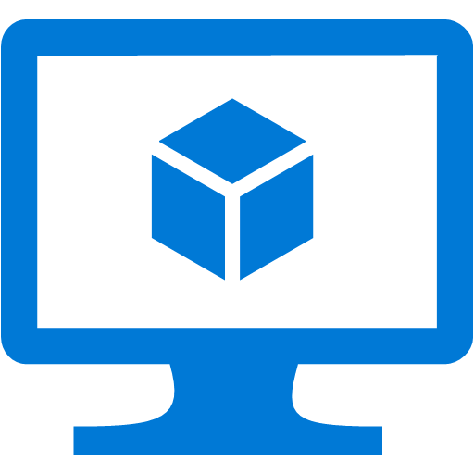
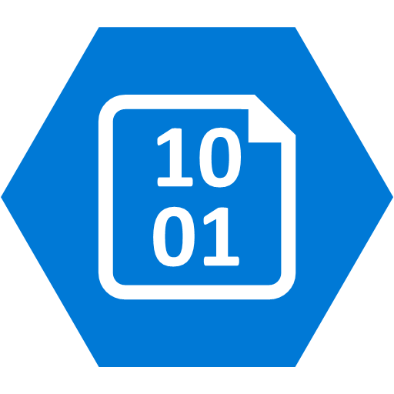






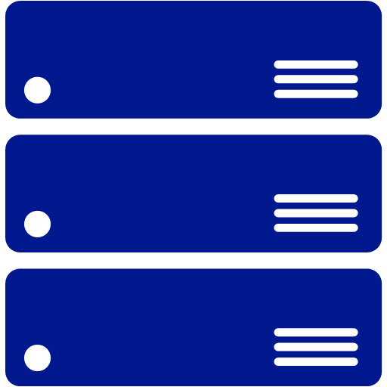
Platform Services
Security & Management
Hybrid
Cloud
Media & CDN
Application Platform
Data
Security Center
SQL
Database
Azure AD
Health Monitoring
Media Services
Media Analytics
Content Delivery
Network
Web
Apps
Mobile
Apps
SQL Data
Warehouse
CosmosDB
Portal
AD Privileged
Identity
Management
Azure Active
Directory
Integration
SQL Server
Stretch Database
Redis
Cache
Storage
Tables
Azure
Search
API
Apps
Cloud
Services
Azure AD
B2C
API
Management
BizTalk
Services
Domain Services
Service
Fabric
Notification
Hubs
Intelligence
Multi-Factor
Authentication
Logic
Apps
Functions
Cognitive Services
Bot Framework
Cortana
Backup
Service Bus
Automation
Developer Services
Analytics & IoT
Operational
Analytics
Compute Services
Scheduler
HDInsight
Machine
Learning
Visual Studio
Mobile
Engagement
Stream Analytics
Import/Export
Key Vault
Container
Service
VM
Scale Sets
Data
Catalog
Data Lake
Analytics Service
Data Lake Store
Store/
Marketplace
Batch
VS Team Services
Xamarin
Azure Site
Recovery
RemoteApp
Application
Insights
HockeyApp
IoT Hub
Event
Hubs
Data
Factory
Power BI
Embedded
VM Image Gallery
& VM Depot
Dev/Test Lab
StorSimple
Compute
Storage
Networking
Virtual Machines
Containers
Blob
Queues
Files
Disks
Virtual Network
Load Balancer
DNS
Express
Route
Traffic Manager
VPN Gateway
App
Gateway

Slide 13
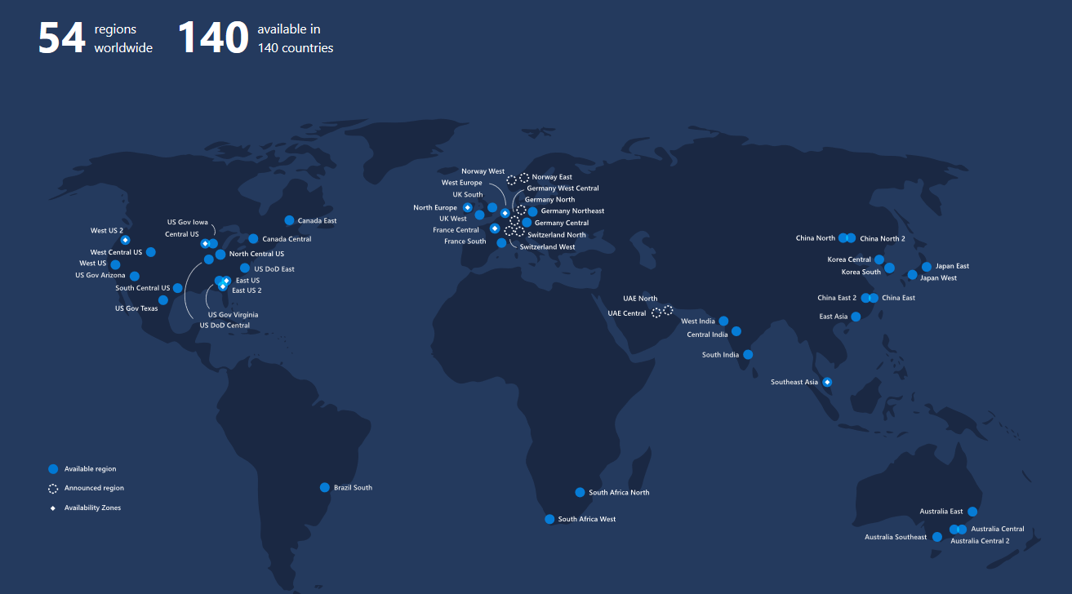
Notes:
https://azure.microsoft.com/en-us/global-infrastructure/regions/
Azure regions
Azure has more global regions than any other cloud provider—offering the scale needed to bring applications closer to users around the world, preserving data residency, and offering comprehensive compliance and resiliency options for customers.
54
regions worldwide
140
available in 140 countries

Slide 14
Azure Active Directory
Simple Connection (AAD Connect)
Single Sign-On
Windows Server
Active Directory
Username
•••••••••••
Other Directories
SaaS
Azure
Public
cloud
Office 365
On-premises
Cloud
Microsoft Azure Active Directory
One user. One identity. Everywhere
B2B
B2C
Notes:
Microsoft has a solution for this
[Click] Traditional identity and access management solutions providing sing-sign on to on-premises applications and directory services such as Active Directory and others are used from the vast majority of organizations and huge investments were made to deploy and maintain them. These solutions are perfect for the on-premises world.
[Click] Now, as we have discussed, there are new pressing requirements to provide the same experience to cloud applications hosted in any public cloud.
[Click] Azure Active Directory can be the solution to this new challenge by extending the reach of on-premises identities to the cloud in a secure and efficient way.
[Click] In order to do that, one simple connection is needed from on-premises directories to Azure AD.
[Click] and everything else will be handled by Azure AD. Secure single sign-on to thousands of SaaS applications hosted in any cloud by using the same credentials that exist on-premises
[Click] And we don’t forget the users. Azure AD provides Self-service capabilities and easy access to all the application, consumer or business, they need.
in the cloud but on-premises too (Application Proxy)
B2B (Business 2 Business) – Azure AD collaboration capability with users from other organization
B2C (Business 2 Consumer) - Azure AD for consumer-facing applications that scales to hundreds of millions of identities

Slide 15
Enterprise Enrolment
Department A
Account A
Department B
Account C
Subscription 4
Account B
Subscription 1
Subscription 2
Subscription 3
Enterprise Administrator
http://ea.azure.com
Department Administrator
Account Owner
http://account.windowsazure.com/
Notes:
The objective of this slide is to show the Azure Account structure, with the types of Accounts used, split by EA / non-EA, and the URLs used to manage said structure.
Blue is for EA only. Grey is for both EA & non-EA
Talk to what subscriptions are:
Named Container (Cloud Services)
Security Boundary (RBAC)
Purchase Plan (Azure Offers)
Billing Interface (Cost Code)

Slide 16

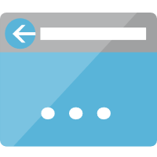
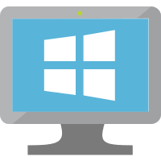



Subscriptions, Resource Groups and Resources
Subscription
Resource Group
Resource Group
Resource Group
Notes:
ANIMATED SLIDE
<CLICK>
Anything in Azure is a resource.
It could be a storage account, a database, a website or a virtual machine.
All of these are resources.
<CLICK>
A resource must belong to a resource group
A resource group is a logical container that resources.
It can be used as a boundary for tags, security, policy and access controls.
There is no cost for a Resource Group
<CLICK>
Resource Groups live within a subscription.
A subscription is a logical container that is consider to be a boundary for billing purposes.
Anything resources inside a subscription will end up on the same bill.

Slide 17

Subscriptions, Resource Groups and Resources
Subscription
Region
Region
Resource Group
Resource Group
Resource Group
Notes:
ANIMATED SLIDE
<CLICK>
Anything in Azure is a resource.
It could be a storage account, a database, a website or a virtual machine.
All of these are resources.
<CLICK>
A resource must belong to a resource group
A resource group is a logical container that resources.
It can be used as a boundary for tags, security, policy and access controls.
There is no cost for a Resource Group
<CLICK>
Resource Groups live within a subscription.
A subscription is a logical container that is consider to be a boundary for billing purposes.
Anything resources inside a subscription will end up on the same bill.

Slide 18
Subscriptions

Slide 19
Identity Best Practices
Enable single sign on
Enable MFA
Turn on Conditional Access
Use RBAC
Enable password management - Custom
Limit administrator access – Privileged Identity Management
Notes:
https://blogs.msdn.microsoft.com/azuregov/2019/02/19/six-tips-for-securing-identity-in-the-cloud/
Azure Active Directory helps you enhance security, simplify access, and set smart policies with a single identity platform. For example, you can implement secure single sign-on for any application faster, more easily, and from any device.
This identity platform provides you with many options for managing identities. Here are six best practices for securing identities that you can implement today.
Enable single sign-on. Your users can use the same set of credentials to sign in and access the resources that they need, whether the resources are located on-premises or in the cloud.
Enforce multi-factor verification for users, especially your administrator accounts. Azure Multi-Factor Authentication (Azure MFA) helps administrators protect their organizations and users with additional methods such as token or phone authentication.
Turn on Conditional Access. With Azure AD conditional access, you can make automated access control decisions for accessing your cloud apps based on specified conditions. By doing this, every login will be scored to assess its risk and the engine will take actions to reduce it.
Use Role Based Access Control (RBAC). Restricting access based on the need to know and least privilege security principles is imperative for organizations that need to enforce security policies for data access.
Enable password management and use appropriate security policies to prevent misuse.
Global banned password list
Preview: Custom banned password list – Azure AD P1 and P2 required for AD synced accounts
AAD users need AAD Basic for custom list, covered by Global List
Limit administrator access to a limited set of users. You can leverage Privileged Identity Management to ensure a just-in-time approach to obtain the required rights.
[EDITOR] TWB_Trevor:
09 October 2013 It seems odd to use “finally” here, given that this is not a long process – or, at least, has not been described in great detail. Kindly consider removing it, or replacing it with something that clarifies context.

Slide 20
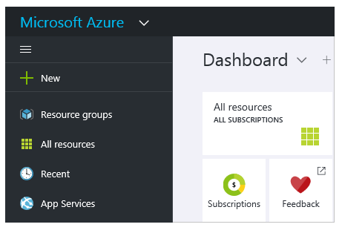
Azure Resource Manager (ARM)
Declarative programming model
JSON Syntax
Notes:
This is where Azure Resource Manager (ARM) comes in. Azure Resource Manager or (ARM) is the new Azure deployment service that was released in 2015 and supersedes the ASM deployment service. It was first announced at Build 2014 when the new Azure portal was announced and provides a new set of API’s that are used to provision resources. ARM facilitates a modular approach to resources meaning that, resources are not dependent on other resources and can exist on their own. Role based access control and template based deployment are also new in the ARM service.

Slide 21
Resource Groups
Resource – managed Azure item e.g. VM, NIC, storage account
Resource Group - container holding related resources
Resource Group - maximum 800 resources, cannot be nested
Resource - can only exist in one resource group
Resource - add or remove from resource group any time
Resource Group - can contain resources in different regions
Notes:
What are Azure Resource Groups? In order to understand what a resource group is, it’s important to know what a resource is. A resource is a manageable item that is available through Azure. Some common resources are a virtual machine, storage account, virtual network, web app and database, but there are many more.
A resource group is a container that holds related resources for an application or service. A resource group can include all of the resources for an application or service, or only those resources that you group together. You can decide how you want to allocate resources to resource groups based on what makes the most sense for your organization.
Each resource group can contain a maximum of 800 resources and can not be nested.
A resource can only exist in one resource group at a time.
You can add or remove resources to a resource group at any time, and
A resource group can contain resources that reside in different regions. Giving you more flexibility for your solution.
[EDITOR] TWB_Trevor:
09 October 2013 It seems odd to use “finally” here, given that this is not a long process – or, at least, has not been described in great detail. Kindly consider removing it, or replacing it with something that clarifies context.

Slide 22
Management Policies

Slide 23
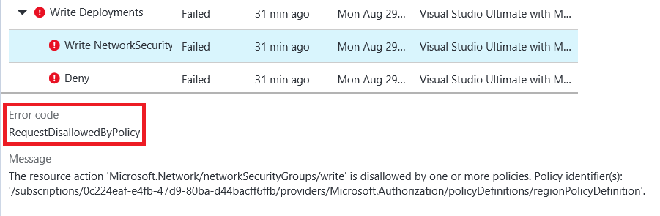
Management Policies
Enforce polices during resource deployment
Examples
VM size
Location
Naming Convention
Notes:
Management Policies. ARM Management Policies allow you to enforce polices during resource deployment e.g. only a specific VM size, Location and Naming Convention can be used during a deployment. This allows you to maintain a consistent environment and have more control over how resources are deployed. It is important to note that management policies compliment the role based access control feature in that role based access control is user focused whereas management policies are resource focused.
Policies are created and managed using PowerShell or the REST API and can be
Applied at subscription, resource group or resource level. Policies are also inherited by all child resources and have their
Events audited which can be viewed in the portal or using PowerShell. Lastly,
Policies are cumulative, this means that the policy result is a sum of all policies that have been applied to the respective resource.
[EDITOR] TWB_Trevor:
09 October 2013 It seems odd to use “finally” here, given that this is not a long process – or, at least, has not been described in great detail. Kindly consider removing it, or replacing it with something that clarifies context.

Slide 24
Management Policies
Management Policies compliment RBAC
RBAC is user focused
Management Policies are resource focused
Notes:
Management Policies. ARM Management Policies allow you to enforce polices during resource deployment e.g. only a specific VM size, Location and Naming Convention can be used during a deployment. This allows you to maintain a consistent environment and have more control over how resources are deployed. It is important to note that management policies compliment the role based access control feature in that role based access control is user focused whereas management policies are resource focused.
Policies are created and managed using PowerShell or the REST API and can be
Applied at subscription, resource group or resource level. Policies are also inherited by all child resources and have their
Events audited which can be viewed in the portal or using PowerShell. Lastly,
Policies are cumulative, this means that the policy result is a sum of all policies that have been applied to the respective resource.
[EDITOR] TWB_Trevor:
09 October 2013 It seems odd to use “finally” here, given that this is not a long process – or, at least, has not been described in great detail. Kindly consider removing it, or replacing it with something that clarifies context.

Slide 25
Management Policies
Applied at
Subscription
Resource group
Resource level
Inherited by all child resources
Notes:
Management Policies. ARM Management Policies allow you to enforce polices during resource deployment e.g. only a specific VM size, Location and Naming Convention can be used during a deployment. This allows you to maintain a consistent environment and have more control over how resources are deployed. It is important to note that management policies compliment the role based access control feature in that role based access control is user focused whereas management policies are resource focused.
Policies are created and managed using PowerShell or the REST API and can be
Applied at subscription, resource group or resource level. Policies are also inherited by all child resources and have their
Events audited which can be viewed in the portal or using PowerShell. Lastly,
Policies are cumulative, this means that the policy result is a sum of all policies that have been applied to the respective resource.
[EDITOR] TWB_Trevor:
09 October 2013 It seems odd to use “finally” here, given that this is not a long process – or, at least, has not been described in great detail. Kindly consider removing it, or replacing it with something that clarifies context.

Slide 26
Management Policies
Policy events are audited
Policies are cumulative
Notes:
Management Policies. ARM Management Policies allow you to enforce polices during resource deployment e.g. only a specific VM size, Location and Naming Convention can be used during a deployment. This allows you to maintain a consistent environment and have more control over how resources are deployed. It is important to note that management policies compliment the role based access control feature in that role based access control is user focused whereas management policies are resource focused.
Policies are created and managed using PowerShell or the REST API and can be
Applied at subscription, resource group or resource level. Policies are also inherited by all child resources and have their
Events audited which can be viewed in the portal or using PowerShell. Lastly,
Policies are cumulative, this means that the policy result is a sum of all policies that have been applied to the respective resource.
[EDITOR] TWB_Trevor:
09 October 2013 It seems odd to use “finally” here, given that this is not a long process – or, at least, has not been described in great detail. Kindly consider removing it, or replacing it with something that clarifies context.

Slide 27
Policy Definition structure
Policy definition is created using JSON.
Conditions/logical operators
Define actions and an effect
Notes:
Policy Definition structure. The management policy definition is created using the JSON format which is then called by PowerShell or the REST API.
It consists of one or more conditions or logical operators which define the actions and an effect which tells what happens when the conditions are fulfilled.
At a minimum, a policy contains: Condition or Logical operators which are a set of conditions that can be manipulated through a set of logical operators and it contains an Effect. The Effect describes what the result will be when the condition is satisfied. There are 3 different types of Effect. Deny, audit or append.
Deny generates an event in the audit log and fails the request,
Audit generates an event in audit log but does not fail the request and lastly
Append which adds a defined set of fields to the request.
[EDITOR] TWB_Trevor:
09 October 2013 It seems odd to use “finally” here, given that this is not a long process – or, at least, has not been described in great detail. Kindly consider removing it, or replacing it with something that clarifies context.

Slide 28
Resource Locks

Slide 29
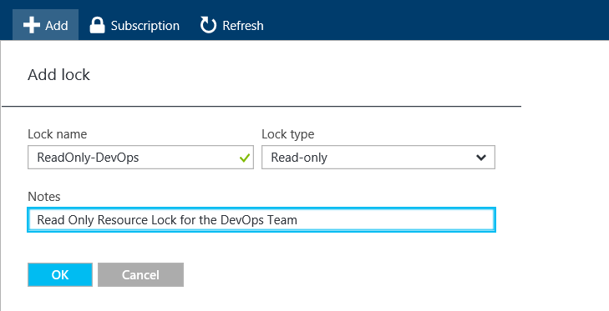
Resource Locks
Prevent accidental deletion or modification
Resource groups
Resources
Delete or ReadOnly
Applies to Everyone
Notes:
Resource Locks. As an administrator, you may need to lock a subscription, resource group, or resource to prevent other users in your organization from accidentally deleting or modifying critical resources. Using ARM Resource Locks, you’re now able to do this. You can set the lock level to, CanNotDelete or ReadOnly.
CanNotDelete means authorized users can still read and modify a resource, but they can't delete it.
ReadOnly means authorized users can read from a resource, but they can't delete it or perform any actions on it, effectively, the permission on the resource is restricted to the Reader role.
Resource locks apply to Everyone, including Administrators.
It is also important to note that applying a ReadOnly lock can lead to unexpected results because some operations that seem like read operations actually require additional actions. For example, placing a ReadOnly lock on a storage account prevents all users from listing the keys. The list keys operation is handled through a POST request because the returned keys are available for write operations. For another example, placing a ReadOnly lock on an App Service resource prevents Visual Studio Server Explorer from displaying files for the resource because that interaction requires write access. Use this resource lock type with caution.
[EDITOR] TWB_Trevor:
09 October 2013 It seems odd to use “finally” here, given that this is not a long process – or, at least, has not been described in great detail. Kindly consider removing it, or replacing it with something that clarifies context.

Slide 30
Resource Lock Management
Applied at the
subscription
resource group
resource level
Notes:
Resource Lock Management. Resource locks can be created using the Azure portal, ARM templates, PowerShell or REST API. They are
Applied at the subscription, resource group or resource level and its good to note that
When a resource lock is applied on a parent resource, all child resources inherit the same lock, even resources you add later inherit the lock from the parent. In order to create and delete resource locks, you must have the
Owner or User Access Administrator permission at the respective scope level.
[EDITOR] TWB_Trevor:
09 October 2013 It seems odd to use “finally” here, given that this is not a long process – or, at least, has not been described in great detail. Kindly consider removing it, or replacing it with something that clarifies context.

Slide 31
Resource Lock Management
When a lock is applied at a parent scope
All child resources inherit the same lock
Resources you add later inherit the lock from the parent
Notes:
Resource Lock Management. Resource locks can be created using the Azure portal, ARM templates, PowerShell or REST API. They are
Applied at the subscription, resource group or resource level and its good to note that
When a resource lock is applied on a parent resource, all child resources inherit the same lock, even resources you add later inherit the lock from the parent. In order to create and delete resource locks, you must have the
Owner or User Access Administrator permission at the respective scope level.
[EDITOR] TWB_Trevor:
09 October 2013 It seems odd to use “finally” here, given that this is not a long process – or, at least, has not been described in great detail. Kindly consider removing it, or replacing it with something that clarifies context.

Slide 32
Resource Lock Management
Owner and User Access Administrator can
Create resource locks
Delete resource locks
Notes:
Resource Lock Management. Resource locks can be created using the Azure portal, ARM templates, PowerShell or REST API. They are
Applied at the subscription, resource group or resource level and its good to note that
When a resource lock is applied on a parent resource, all child resources inherit the same lock, even resources you add later inherit the lock from the parent. In order to create and delete resource locks, you must have the
Owner or User Access Administrator permission at the respective scope level.
[EDITOR] TWB_Trevor:
09 October 2013 It seems odd to use “finally” here, given that this is not a long process – or, at least, has not been described in great detail. Kindly consider removing it, or replacing it with something that clarifies context.

Slide 33
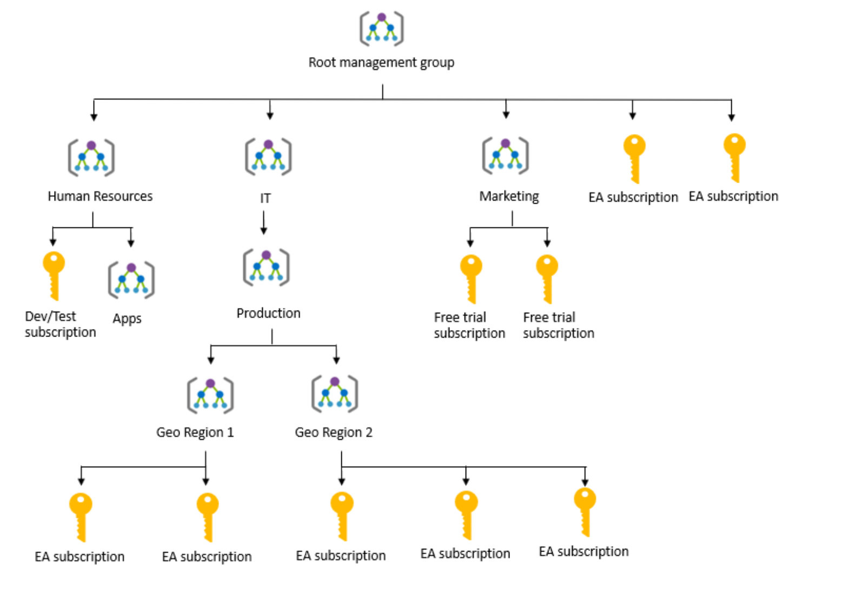
Enterprise governance management
Notes:
https://docs.microsoft.com/en-us/learn/modules/intro-to-governance/4-management-groups
[EDITOR] TWB_Trevor:
09 October 2013 It seems odd to use “finally” here, given that this is not a long process – or, at least, has not been described in great detail. Kindly consider removing it, or replacing it with something that clarifies context.

Slide 34

Azure Blueprints
Role assignments
Policy assignments
Azure Resource Manager templates
Resource groups
Notes:
Azure Blueprint allows you to define a repeatable set of Azure resources that implement and adhere to your organization's standards, patterns, and requirements. Blueprint enables development teams to rapidly build and deploy new environments with the knowledge that they're building within organizational compliance with a set of built-in components that speed up development and delivery.
https://docs.microsoft.com/en-us/learn/modules/intro-to-governance/5-azure-blueprints
[EDITOR] TWB_Trevor:
09 October 2013 It seems odd to use “finally” here, given that this is not a long process – or, at least, has not been described in great detail. Kindly consider removing it, or replacing it with something that clarifies context.

Slide 35
Azure Security Center

Slide 36
Azure Security Center
Unified security management
Hybrid Clouds
Notes:
Azure Security Center
https://docs.microsoft.com/en-us/azure/security-center/
Azure service that allows customers to:
Gain visibility and control into their Azure infrastructure
Integrate 3rd party partner solutions with a click of a button
Detect attacks on resources deployed in the environment
Three main pillars:
Prevention pillar helps you harden your environment (recommendations, visibility) – Free of charge
Detection pillar helps you detect gaps in your prevention strategy (threats) – ASC Standard or OMS Security
Respond Pillar, Advanced Cloud Defense – tools to stay productive and secure.
Free vs Standard
https://azure.microsoft.com/en-us/pricing/details/security-center/
Out of the box notable events in the dashboard, or create custom queries.
It’s important to note that Security Centre being IN the cloud is updated at the speed of the cloud. If we update things internally due to a new vulnerability being identified then it is pushed globally. Gone are the days of having to wait for the monthly virus definition and signature updates.
The recommended controls take the guess work out of your security and forensic posture. You’re presented with an aggregated timeline of an event with the recommendations on the steps to take to mitigate the issues. Allowing you to react much quicker than you normally would, while allocating resources to the right things rather than just hunting through event logs attempting to ascertain what happened and where.

Slide 37
Azure Security Center
Strengthen security posture
Manage organization security policy and compliance
Continuous assessments
Optimize and improve security
Advanced threat protection
Notes:
Out of the box notable events in the dashboard, or create custom queries.
It’s important to note that Security Centre being IN the cloud is updated at the speed of the cloud. If we update things internally due to a new vulnerability being identified then it is pushed globally. Gone are the days of having to wait for the monthly virus definition and signature updates.
The recommended controls take the guess work out of your security and forensic posture. You’re presented with an aggregated timeline of an event with the recommendations on the steps to take to mitigate the issues. Allowing you to react much quicker than you normally would, while allocating resources to the right things rather than just hunting through event logs attempting to ascertain what happened and where.
Important to note that you can monitor resources running in other clouds and on-prem with the monitoring agent.
Additionally you can incorporate connected security solutions running in Azure, like firewalls and antimalware. AAD Information Protection as well as any security solution that supported Common Event Format (CEF).

Slide 38
Azure Security Center
Free and Standard
Security policy, assessment, and recommendations
Connected partner solutions
Standard only
Security event collection and search
Just in time VM Access
Notes:
Free vs Standard
https://azure.microsoft.com/en-us/pricing/details/security-center/

Slide 39
Azure Security Center
Standard only
Adaptive application controls
Advanced threat detection
Built-in and custom alerts
Threat intelligence
Regulatory Compliance Dashboard (Preview)
Notes:
Free vs Standard
https://azure.microsoft.com/en-us/pricing/details/security-center/

Slide 40
Azure Security Center
Policy and Compliance
Coverage
Secure Score
Security Policy
Regulatory Compliance
Resource Security Hygiene
Notes:
You are covered for your security score out of the box with the Free Tier, however it is important to note that you are required to upgrade to the Standard Tier to get access to Threat Protection and the advanced protections.
Your secure score is based on our recommended security posture, and you’re attributed a score based on how close to meeting the requirements you are.
As organisations become more global, it’s important to be aware of your regulatory compliance. This feature is currently in preview however will expand to include more regulations as time goes on. Again, enabled out of the box and with specific recommendations on what you need to fix to bring your organization in line.

Slide 41
Azure Security Center
Advanced Cloud Defense
Adaptive application controls
Just in time VM access
File Integrity Monitoring
Notes:
Adaptive application controls – automated end-to-end app whitelisting built in to ASC. Uses ASC ML to analyse applications running on your VMs and helps you apply whitelisting rules using inbuilt intelligence.
Just in time VM access – with the emphasis on identity being the new security perimeter and giving our admins the least amount of privilege for the least amount of time, comes the ability to provide VM access only for a defined period. And as of recently it has been made available from the VM blade directly.
File Integrity Monitoring is a great way to monitor specific files and registry locations both in MSFT and Linux environments that are key to protecting against malicious actions. If you have specific file shares or registry settings you can add those as custom locations and be notified whenever they are changed.

Slide 42
Azure Security Center
Threat Protection
Security alerts
Custom alert rules
Security alerts map
Automation & Orchestration
Playbooks

Slide 43
Azure Sentinel
Notes:
https://docs.microsoft.com/en-au/azure/sentinel/
https://github.com/Azure/Azure-Sentinel

Slide 44
Azure Sentinel
SIEM as a Service
Cloud native
Baked in Hunt
Notes:
Sentinel gives SIEM capability, complete with baked in Hunt (proactive vulnerability testing) while ASC is focused on "Security posture and protection insights".
Azure Sentinel Preview is a cloud-native SIEM that provides intelligent security analytics for your entire enterprise at cloud scale. Get limitless cloud speed and scale to help focus on what really matters. Easily collect data from all your cloud or on-premises assets, Office 365, Azure resources, and other clouds. Effectively detect threats with built-in machine learning from Microsoft’s security analytics experts. Automate threat response, using built-in orchestration and automation playbooks.
https://docs.microsoft.com/en-us/azure/sentinel/

Slide 45
Azure Monitor

Slide 46
Azure Monitor
Metrics and Logs
Insights
Application Insights
Azure Monitor for containers
Azure Monitor for VMs
Monitoring Solutions
Notes:
Azure Monitor Overview
https://docs.microsoft.com/en-au/azure/azure-monitor/overview
Log Analytics Demo environment to practice Kusto Query
http://aka.ms/LADemo
Kusto Query Language (KQL) from Scratch (Pluralsight - Free Course)
https://app.pluralsight.com/library/courses/kusto-query-language-kql-from-scratch/table-of-contents

Slide 47
Azure Monitor
Visualise
Dashboards
Views
Power BI
Workbooks

Slide 48
Azure Monitor
Analyse
Log Analytics
Metrics Explorer
Respond
Alerts
Autoscale

Slide 49
Azure Monitor
Integrate
Event Hubs
Logic Apps
Ingest and Export APIs
Notes:
https://docs.microsoft.com/en-au/azure/azure-monitor/platform/stream-monitoring-data-event-hubs
https://docs.microsoft.com/en-au/azure/azure-monitor/platform/activity-logs-stream-event-hubs

Slide 50
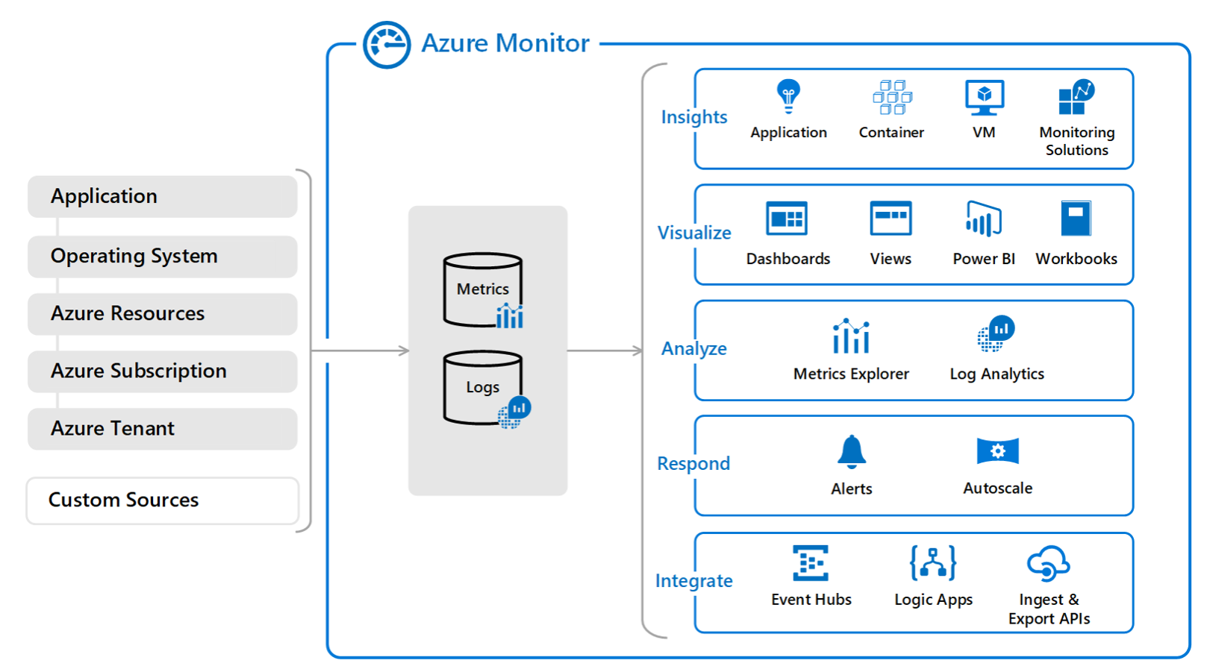
Azure Monitor

Slide 51
Azure Key Vault

Slide 52

Azure Key Vault
Cloud service that works as a secure secrets store
Centralize application secrets
Securely store secrets and keys
Monitor access and use
Simplified administration of application secrets
Integrate with other Azure services
Notes:
What is Azure Key Vault?
https://docs.microsoft.com/en-us/azure/key-vault/
https://docs.microsoft.com/en-us/azure/key-vault/key-vault-overview#securely-store-secrets-and-keys
Azure Key Vault is a cloud service that works as a secure secrets store.
You have passwords, connection strings, and other pieces of information that are needed to keep your applications working. You want to make sure that this information is available but that it is secured. This is where Azure Key Vault can help. Azure Key Vault can help you securely store and manage application secrets.
Key Vault allows you to create multiple secure containers, called vaults. These vaults are backed by hardware security modules (HSMs). Vaults help reduce the chances of accidental loss of security information by centralizing the storage of application secrets. Key Vaults also control and log the access to anything stored in them. Azure Key Vault can handle requesting and renewing Transport Layer Security (TLS) certificates, providing the features required for a robust certificate lifecycle management solution.
Azure Key vault is designed to support any type of secret. By this we mean Key Vault can be used to store passwords, database credentials, API keys and, certificates, which can be either software protected or HSM protected
Why use Azure Key Vault?
Centralize application secrets
Centralizing storage of application secrets in Azure Key Vault allows you to control their distribution. Key Vault greatly reduces the chances that secrets may be accidentally leaked. When using Key Vault, application developers no longer need to store security information in their application. This eliminates the need to make this information part of the code. For example, an application may need to connect to a database. Instead of storing the connection string in the app codes, store it securely in Key Vault.
Your applications can securely access the information they need by using URIs that allow them to retrieve specific versions of a secret after the application’s key or secret is stored in Azure Key Vault. This happens without having to write custom code to protect any of the secret information.
Securely store secrets and keys
Secrets and keys are safeguarded by Azure, using industry-standard algorithms, key lengths, and hardware security modules (HSMs). The HSMs used are Federal Information Processing Standards (FIPS) 140-2 Level 2 validated.
Access to a key vault requires proper authentication and authorization before a caller (user or application) can get access. Authentication establishes the identity of the caller, while authorization determines the operations that they are allowed to perform.
Authentication is done via Azure Active Directory. Authorization may be done via role-based access control (RBAC) or Key Vault access policy. RBAC is used when dealing with the management of the vaults and key vault access policy is used when attempting to access data stored in a vault.
Azure Key Vaults may be either software- or hardware-HSM protected. For situations where you require added assurance you can import or generate keys in hardware security modules (HSMs) that never leave the HSM boundary. Microsoft uses Thales hardware security modules. You can use Thales tools to move a key from your HSM to Azure Key Vault.
Finally, Azure Key Vault is designed so that Microsoft does not see or extract your data.
Monitor access and use
Once you have created a couple of Key Vaults, you will want to monitor how and when your keys and secrets are being accessed. You can do this by enabling logging for Key Vault. You can configure Azure Key Vault to:
Archive to a storage account.
Stream to an event hub.
Send the logs to Log Analytics.
You have control over your logs and you may secure them by restricting access and you may also delete logs that you no longer need.
Simplified administration of application secrets
When storing valuable data, you must take several steps. Security information must be secured, it must follow a lifecycle, it must be highly available. Azure Key Vault simplifies a lot of this by:
Removing the need for in-house knowledge of Hardware Security Modules
Scaling up on short notice to meet your organization’s usage spikes.
Replicating the contents of your Key Vault within a region and to a secondary region. Key Vault ensures high availability and takes away the need of any action from the administrator to trigger the failover.
Providing standards Azure administration options via the portal, Azure CLI and PowerShell.
Automating certain tasks on certificates that you purchase from Public CAs, such as enroll and renew.
In addition, Azure Key Vaults allow you to segregate application secrets. Applications may access only the vault that they are allowed to access, and they be limited to only perform specific operations. You can create an Azure Key Vault per application and restrict the secrets stored in a Key Vault to a specific application and team of developers.
Integrate with other Azure services
As a secure store in Azure, Key Vault has been used to simplify scenarios like Azure Disk Encryption, the always encrypted functionality in SQL server and Azure SQL, Azure web apps. Key Vault itself can integrate with storage accounts, event hubs, and log analytics.
What is managed identities for Azure resources?
https://docs.microsoft.com/en-us/azure/active-directory/managed-identities-azure-resources/overview

Slide 53
Azure Network Security
Notes:
https://docs.microsoft.com/en-us/azure/networking/networking-overview
Microsoft Networking Academy
https://www.youtube.com/channel/UCy6v89YQ_u12dsxK4FH0NuA

Slide 54
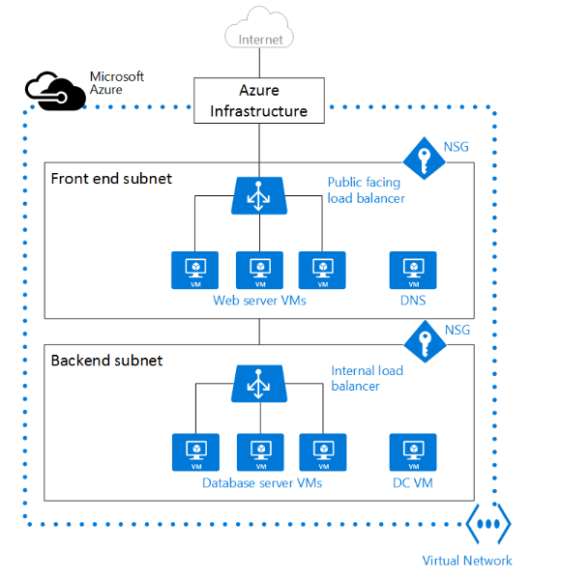
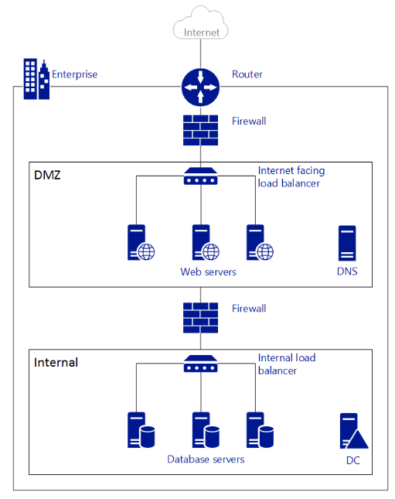
Networking
Notes:
The figure above shows an on-premises network connected to the public Internet through a router. You can also see a firewall between the router and a DMZ hosting a DNS server and a web server farm. The web server farm is load balanced using a hardware load balancer that is exposed to the Internet, and consumes resources from the internal subnet. The internal subnet is separated from the DMZ by another firewall, and hosts Active Directory Domain Controller servers, database servers, and application servers. The same network can be hosted in Azure on the right hand side.
Notice how the Azure infrastructure takes on the role of the router, allowing access from your VNet to the public Internet without the need of any configuration. Firewalls can be substituted by Network Security Groups (NSGs) applied to each individual subnet. And physical load balancers are substituted by internet facing and internal load balancers in Azure.

Slide 55
Azure Network Security
Network Security Groups
Virtual Appliances
Point to Site VPN
Site to Site VPN
EXPRESSROUTE
VNET Peering

Slide 56
Azure Network Security
Service Endpoints
Forced Tunneling
User Defined Routing
BGP Routing
DDOS Protection
Network Watcher
Notes:
Azure DDoS Protection Standard overview
https://docs.microsoft.com/en-au/azure/virtual-network/ddos-protection-overview

Slide 57
Azure Storage Security

Slide 58
Azure Storage Security
Access Keys
SAS Signatures
Storage Encryption
Disk Encryption
Service Endpoint
Secure Transfer
Notes:
https://docs.microsoft.com/en-us/azure/storage/

Slide 59
Azure Storage Security
Advanced Threat Protection
TLS for Azure Storage Client
Notes:
Advanced Threat Protection for Azure Storage
https://docs.microsoft.com/en-us/azure/storage/common/storage-advanced-threat-protection
Enable secure TLS for Azure Storage client
https://docs.microsoft.com/en-us/azure/storage/common/storage-security-tls

Slide 60
Azure SQL Security

Slide 61
Azure SQL Security
AAD Authentication
SQL Authentication
Service Endpoint
Advanced Data Security
Auditing
Transparent Data Encryption

Slide 62
Azure SQL Security
Dynamic Data Masking

Slide 63
Labs
Register at
Add URL
Hosted Labs
https://aka.ms/AZSECLABS

